Slide 1
MACHINE LEARNING · NLP · MENTAL HEALTH
Depression Detection
from Tweets
Text Classification with TF-IDF and Multiple Classifiers
Dataset: 123,759 tweets · Dec 2019 – Dec 2020 · Binary Classification: Depressive vs Non-Depressive

Slide 2
PROBLEM & DATASET
The Problem
Dataset
Depression is a leading cause of global disability.
Social media = rich source of emotional signals.
Goal: Automatically detect depressive tweets.
Period: COVID-19 pandemic amplified mental health discussions online.
123,759
cleaned tweets
48.7%
depressive (0)
51.3%
non-depressive (1)

Slide 3
PREPROCESSING PIPELINE
01
02
03
04
05
Data Cleaning
Lemmatization
Exploratory Data Analysis
Ratio Filter
Term Frequency – Inverse Document Frequency.
Remove URLs, @mentions,
hashtag symbols, RT tags.
Drop 10,314 duplicates & NaN rows.
POS tagging + WordNet
lemmatizer. Remove stop
words & tokens < 3 chars.
Word frequencies, TF-IDF
ranking, unigrams, bigrams,
trigrams per class.
Remove 1,656 neutral words
(ratio 0.35–0.65, freq ≥ 50)
from both classes.
Custom stopwords applied.
Max 5K–10K features.
Sublinear TF scaling.
★ Novel contribution: ratio-based neutral word filtering

Slide 4
KEY EDA FINDINGS
Top Depressive (0) Words
Top Non-Depressive (1) Words
sad
awful
anger
nice
love
good
broken
alone
anxiety
lovely
funny
kind
horrible
hate
kill
happy
perfect
honest
bad
difficult
blame
super
more
new
break
much
many
most
shit
Tweet length (words/chars) shows NO significant difference between classes → classification relies entirely on lexical semantics

Slide 5
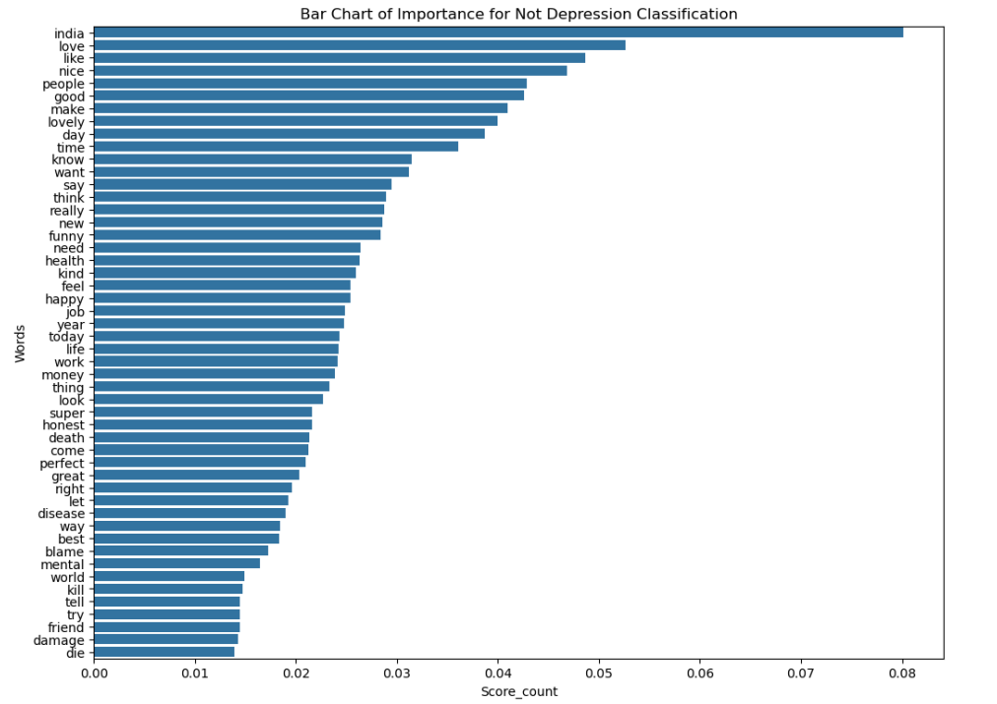
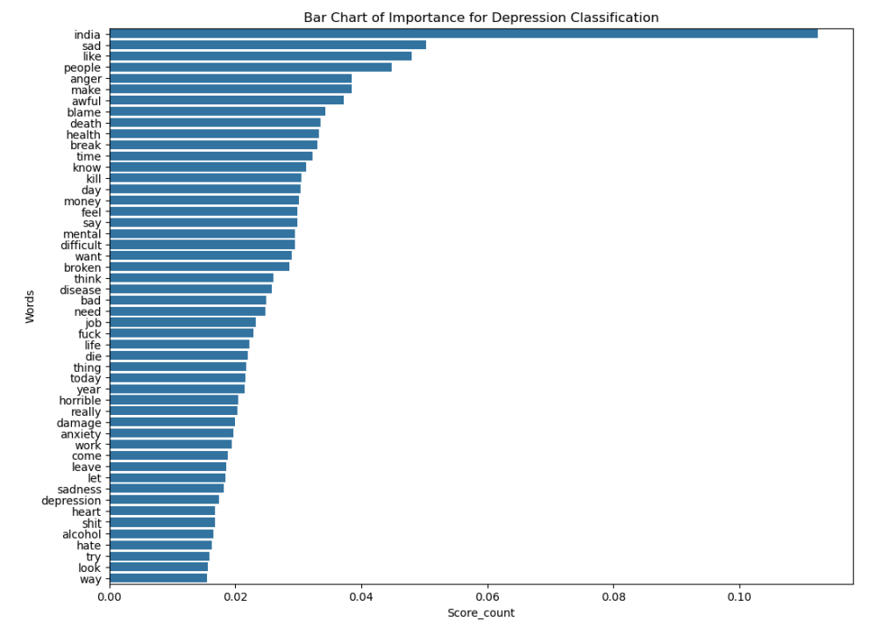
Unigrams

Slide 6

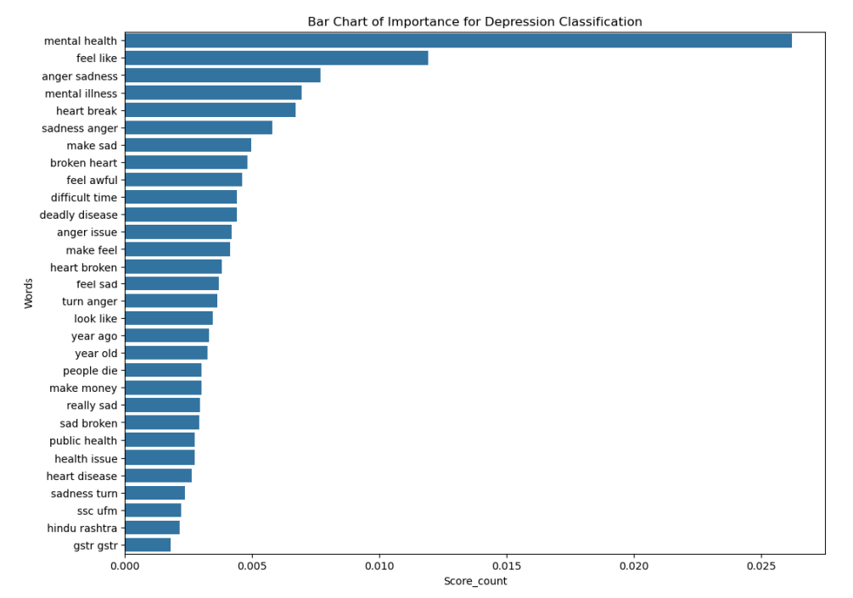
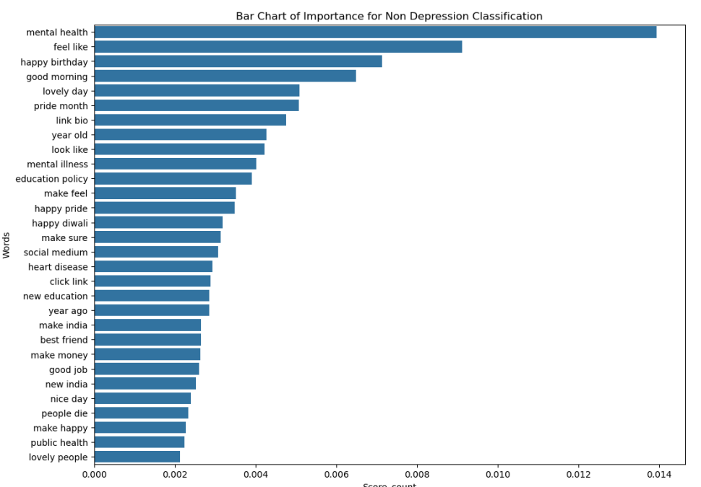
Bigrams

Slide 7
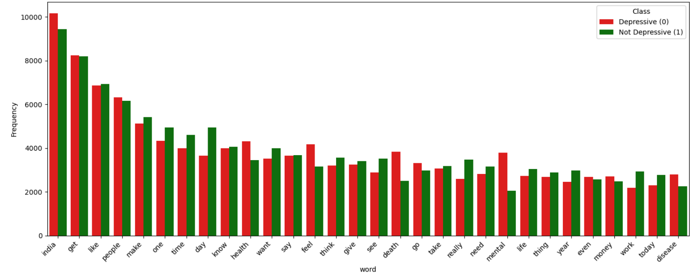
Top 20 neutral words

Slide 8
MODELS & METHODOLOGY
Feature Extraction
Logistic
Regression
Random
Forest
Linear
SVM
TF-IDF vectorization
Transforms text into a numerical matrix, where each document is represented by the weighted importance of its words
Sublinear TF scaling
using log(1 + TF) to reduce the effect of very frequent words while keeping meaningful differences
n-gram: (1,1) or (1,2)
Max features: 5K–10K
5K–10K refers to limiting the number of words (or tokens) the model uses when creating the TF-IDF vectors
Custom stopwords:
Example: "the", "a", "in", "on"
NLTK + 1,656 neutral
standard English stopwords + extra dataset-specific neutral words removed to improve text processing.
ratio-filtered words
common words that appear roughly equally in all classes and are removed because they are uninformative.
80% of data for training, 20% for testing
max_iter=1000
Unigrams+Bigrams
10K features
100 trees
max_depth=25
n_jobs=-1
C=1.0
max_iter=2000
Unigrams+Bigrams
XGBoost
Naive Bayes
(Uni+Bigrams)
Evaluation
n_estimators=100, max_depth=3, learning_rate=0.1
MultinomialNB
5K features
Sublinear TF
Accuracy
Precision / Recall / F1
ROC-AUC
Confusion Matrix

Slide 9
RESULTS & EVALUATION
Best Accuracy: Logistic Regression — 89.0%
NB AUC 0.90–0.91: Strong ranking despite lower accuracy
All models far exceed random baseline (AUC 0.50)

Slide 10
CONCLUSION
Logistic Regression is best overall: 89.0% accuracy, AUC 0.947.
Linear SVM a close second: 87.7%, AUC 0.94.
Naive Bayes achieves AUC 0.90–0.91 — excellent ranking despite lower accuracy.
Ratio-based neutral word filter (1,656 words) improved all models.
Tweet length is NOT a discriminative feature — semantics alone drive classification.
Thank you for your time!

